Slide 1
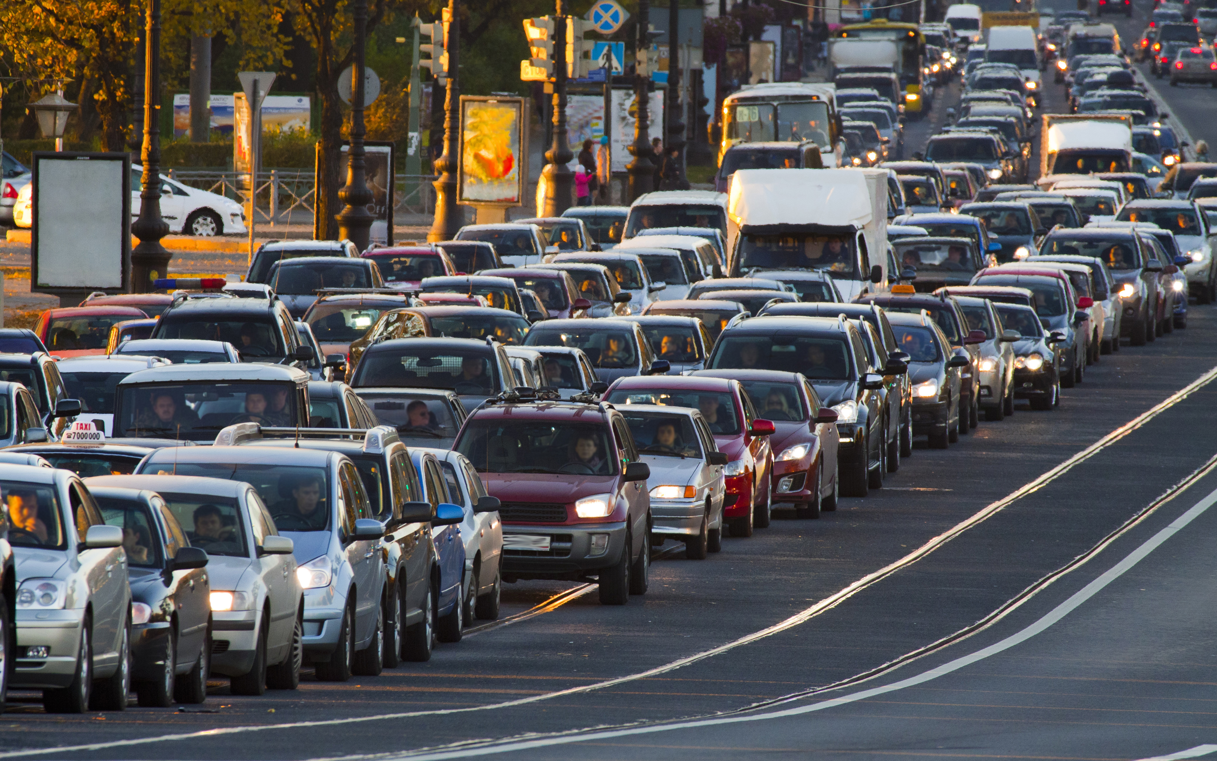
Data visualizations … for the curious
Group1: Bruno Chevalier Gilles Vandewiele Pieter Stroobant Karel Serruys

Slide 2
- Our scope - Our application - Development progress & Responsibilities - Demo - Future improvements

Slide 3
Our Scope
Our client wanted an application that he could use in the context of a practicum for the course “Big Data Science” where the students had to use our application to visualize datasets in order to recognize patterns.
User-friendly & easy to use
Many visualizations (>= 4) that are filterable
High performance in terms of speed
On top of this, we wanted to make the application generic in order to improve future development and to remove the dependencies with the given datasets
Scalable
Generic

Slide 4

Our application: “server-side”
Python scripts to cleanse & compress the data

Slide 5
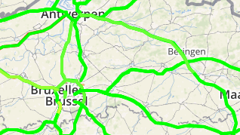
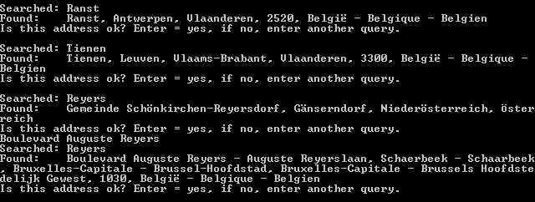
Geocoding
A12 van Laken naar Antwerpen-Zuid, E40 van Oostende naar Brussel, ...

Slide 6
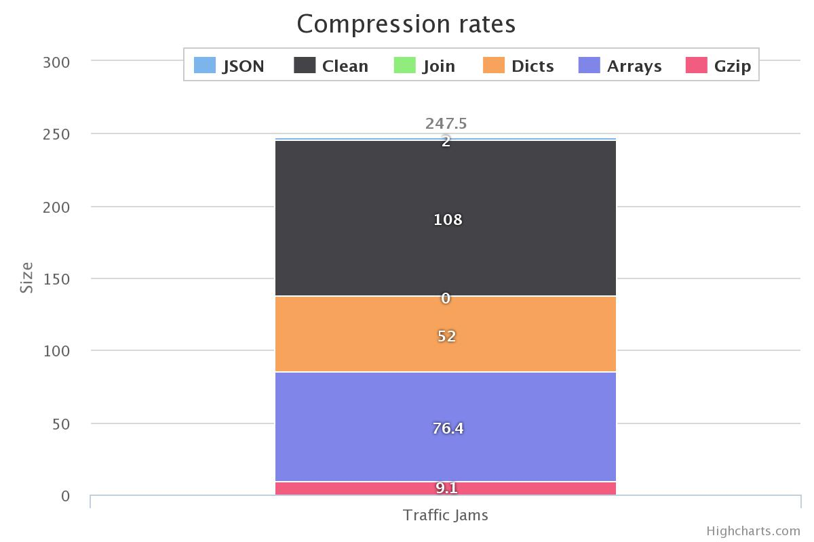
Data compression (1)

Slide 7
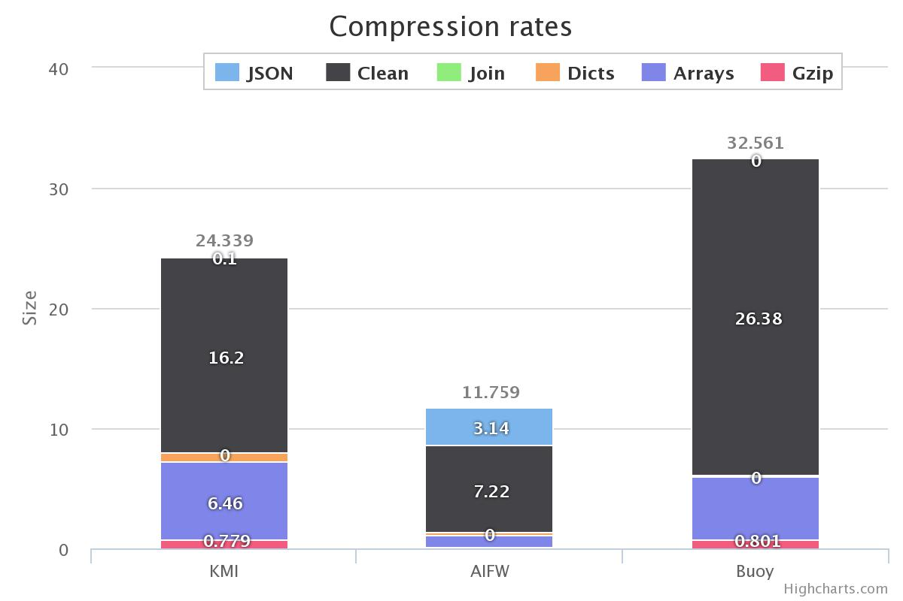
Data compression (2)

Slide 8
Development progress
Phase | Progress
Phase 1: conceptual 13/02/2015 - 26/02/1015 | Get to know the project First version of architecture Non-generic server script
Phase 2: design 26/02/2015 - 12/03/1015 | UML class & sequence diagrams Generic server script to cleanse data Research done about frameworks & libs
Phase 3: development I 12/03/2015 - 26/03/1015 | Homepage First version of start_screen Generic server script that compresses data
Phase 4: development II 26/03/2015 - 30/04/1015 | First visualizations (Map & calendar) User can add own files Finalization of script
Phase 5: finalization 30/04/2015 - 14/05/2015 | Final visualizations Code documentation & cleanup Wiki, progress report & final presentation

Slide 9
Responsibilities
Responsibility | Assigned to
Communication | Gilles
Architecture | Pieter & Gilles
Server-side script | Karel & Pieter
Framework set-up & support | Bruno
Start screen | Gilles
Calendar visualization | Bruno & Gilles
Piechart visualization | Bruno
Multiline chart | Karel
Line chart | Gilles
Bar chart | Karel
Map + timebar | Karel
Data Service | Karel, Pieter & Gilles
Progress reports + documentation | Everyone

Slide 10
DEMO

Slide 11


Our application: “client-side”
A webapplication written in angular (javascript) that allows the user to visualize EVERY dataset with the following format
On time x, values (y1, y2, y3) occurred on location z
Limitations:
For every time x, the number of locations must be fixed
The frequency of x must be higher than day basis (e.g. every 30m)
→ 3 datasets provided:
Weather data: weather information in 9 weather stations
Traffic data: traffic jams on 96 routes
Number of accidents/incidents/speed controls/road works per day

Slide 12
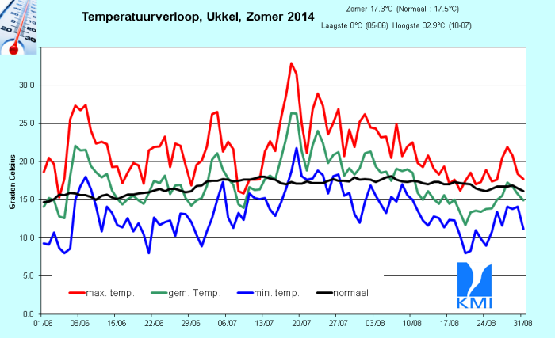
Warmest day of 2014

Slide 13
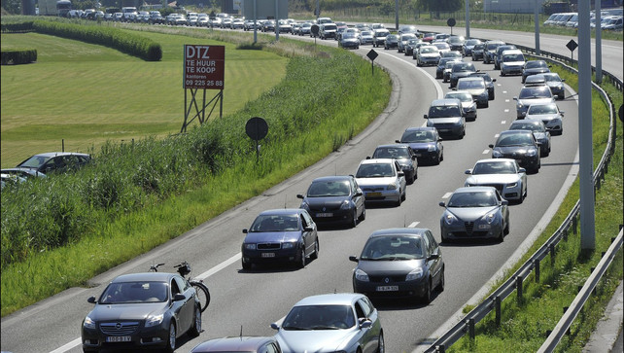
Let's go to the beach!

Slide 14

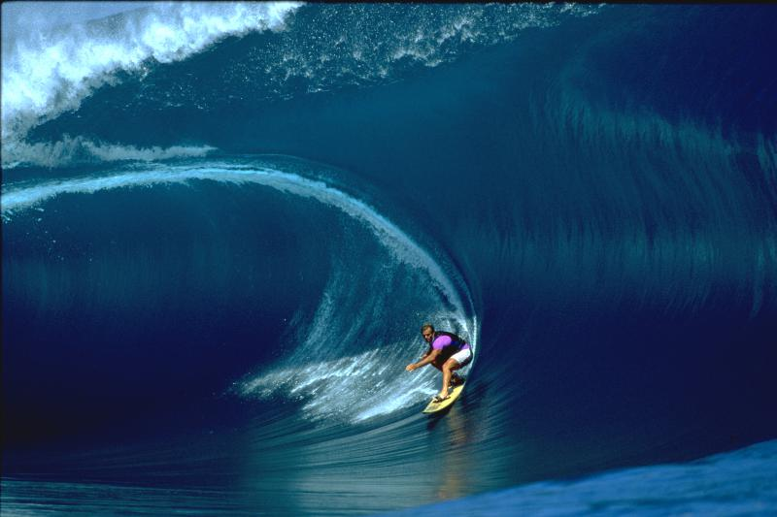
Our own data: wave heights

Slide 15
Future improvements
Support for multiple datasets in the front-end
Support for .gz format for better data compression
More visualizations + dynamic discovery
COUNT aggregation for discreet variables
Remove day restriction
Support for data with lower frequency (year basis)

